Slide 2
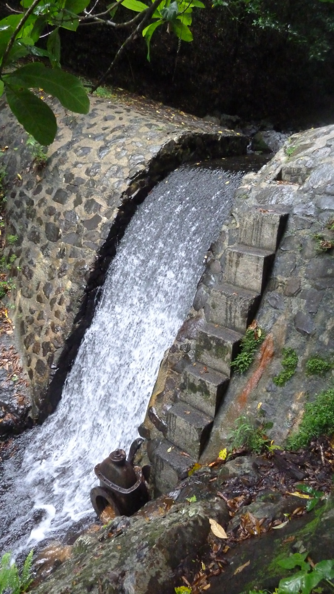
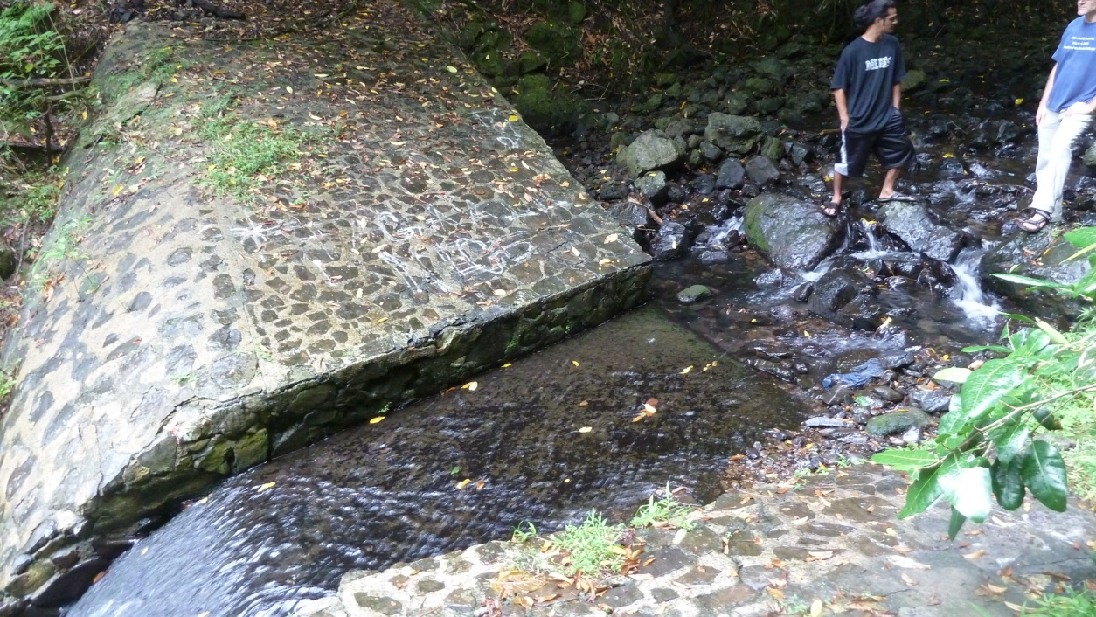
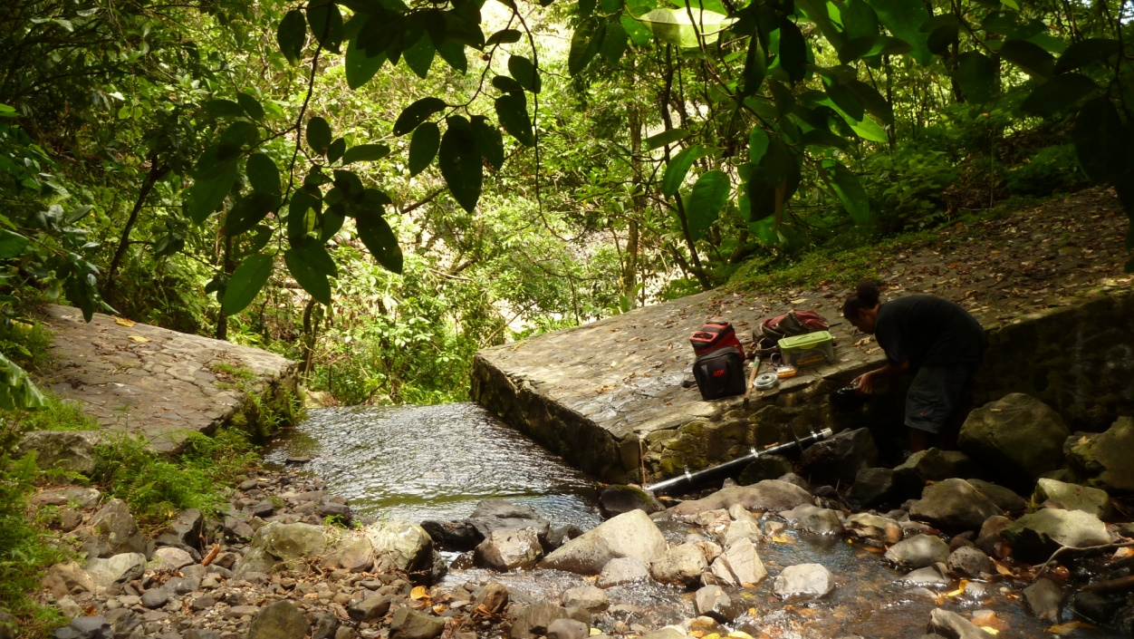
PT 3 Location: “The Dam”
aka Vainoa Resevoir

Slide 3
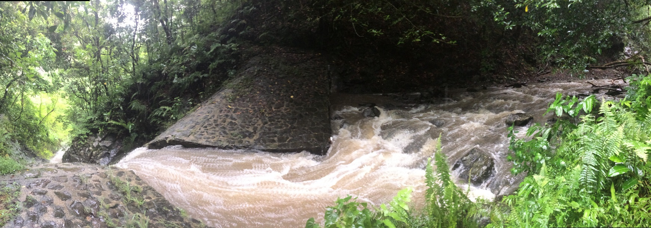
Cross section at Dam, in the structure
Compound Weir (Chin, 2006)
Parshall Flume (Chin, 2006)
Spillway (Chin, 2006)

Slide 4
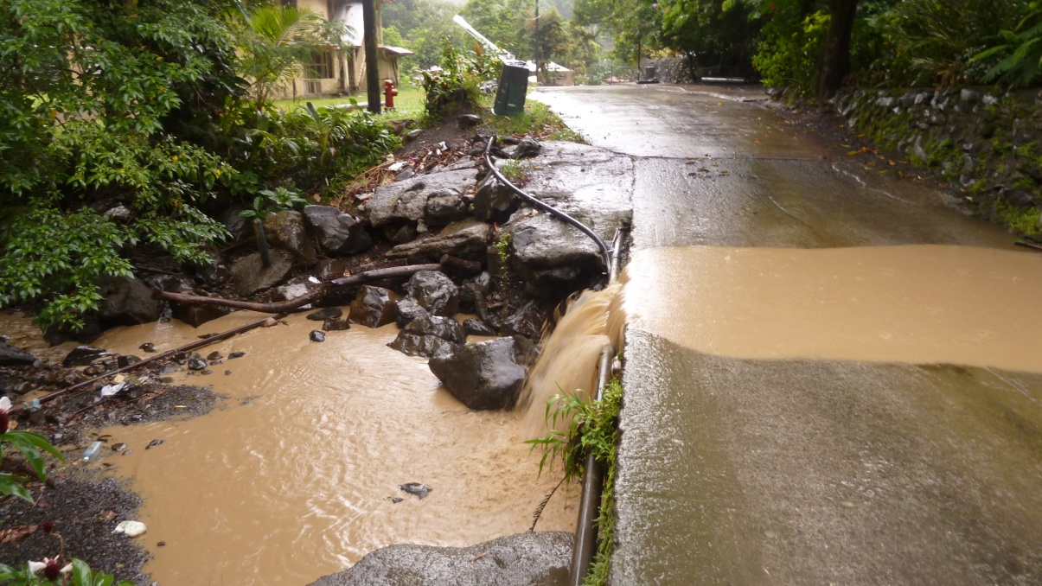
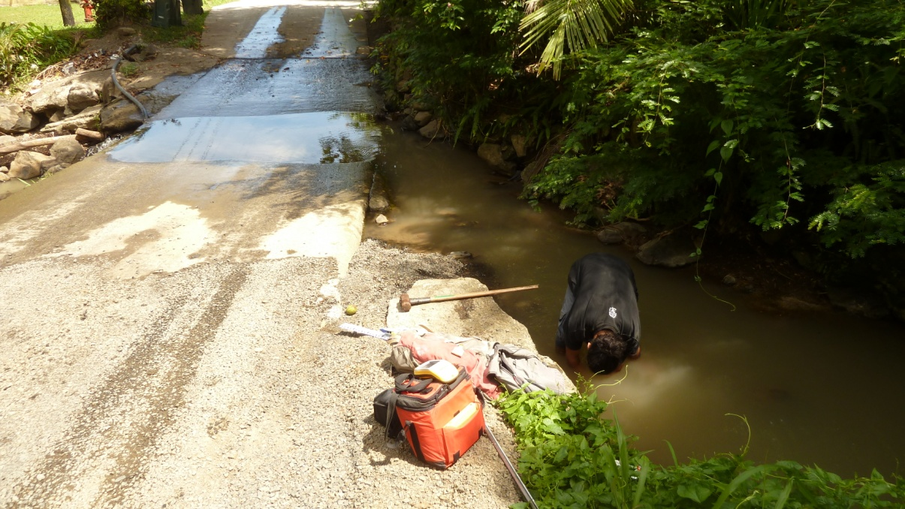
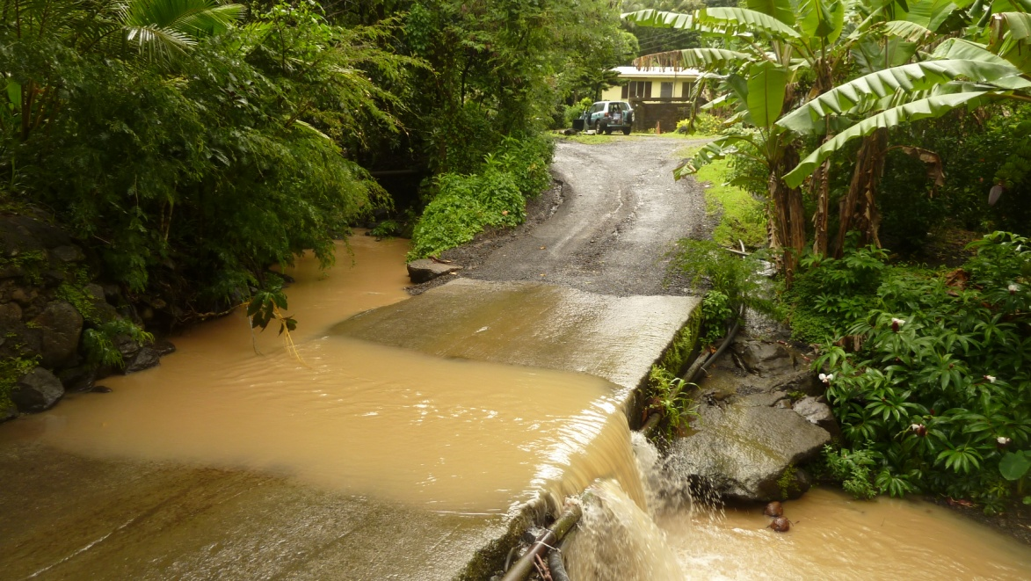
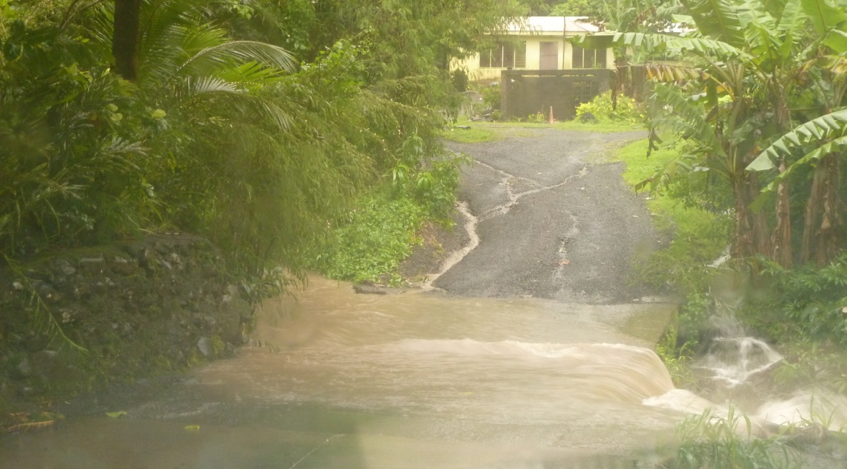
Looking Southeast away from the quarry
PT 2 Location: “Drive-Thru”
Just downstream from the quarry
Looking Northwest towards the quarry

Slide 5
Cross-section at Drive Thru, upstream of culvert
Broad-Crested Weir (Chin, 2006)

Slide 6
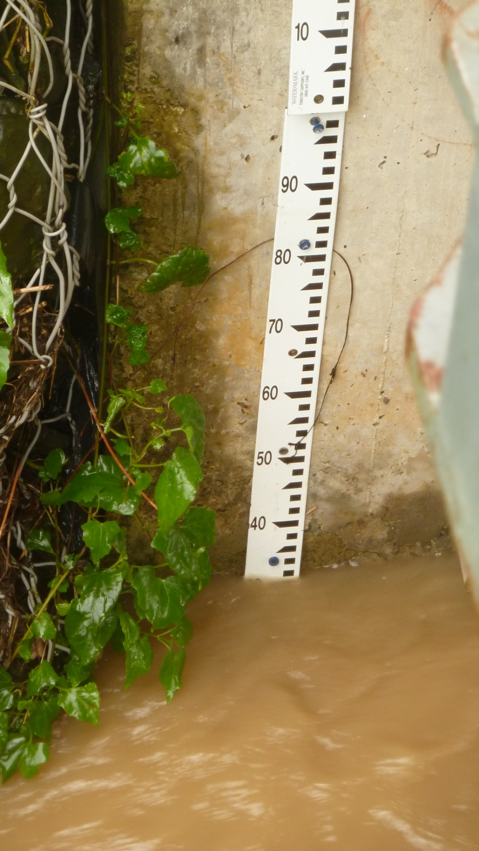
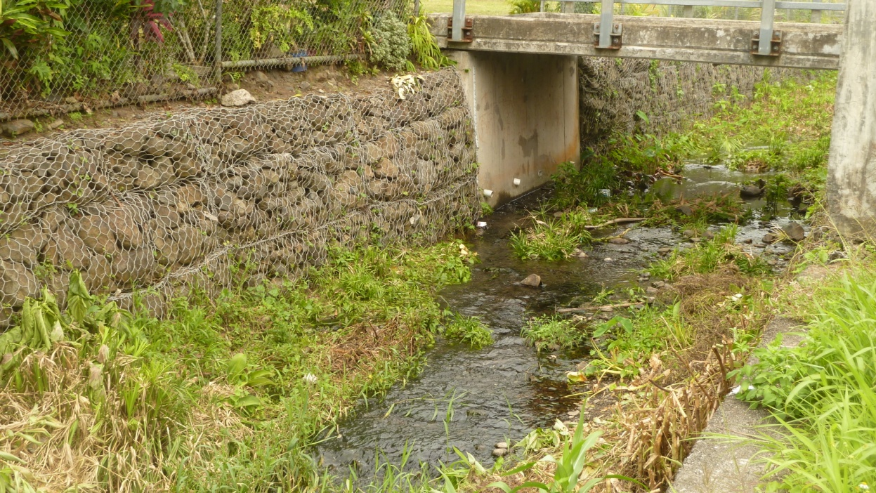
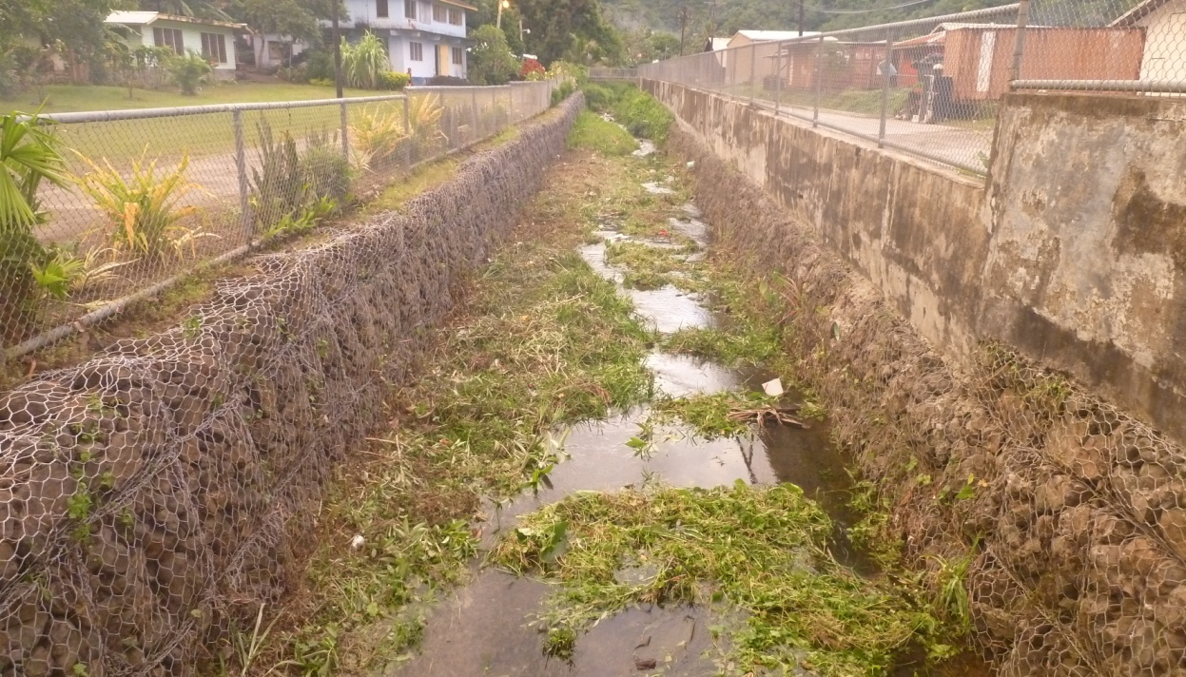
PT 3 Location: “LBJ”
Under bridge behind the LBJ Hospital
Looking upstream from bridge
Staff-Gage next to PT

Slide 7
Cross-section at LBJ, downstream from Bridge
Manning’s Equation (Strickler Equation):

